Slide 1
AUTHORIZED LEAVE MANAGEMENT SYSTEM(ALMS)
Project Guide: Batch No: Project By: Mr. Siva Ratna Sai 17 17N31A0561-Fahad
17N31A0598-Rohit
17N31A05A0-Venkat

Slide 2
CONTENTS
Introduction
Abstract
Existing System
Proposed System
Modules
System Requirement
Architecture
Source Code
Output Screenshots
Conclusion

Slide 3
INTRODUCTION
The main objective of the proposed system is to decrease the paper work and easier record maintenance by having a particular website for leave maintenance.
This approach basically deals with the record of leaves taken by faculty members and students in the organization.
This system also approach to reduce the formalities and time delay facing by the institution.

Slide 4
ABSTRACT:
Online leave management system is an application that is of utmost importance for an organization or college. The leave management application will allow the users to apply for the leaves through the online mode by specifying a valid reason for the leave. This can also be implemented at the school and the college levels where the students can apply for the leaves. The user interface must be simple and easy to understand. The leave applications and the approval are done manually. This work can be automated through the use of this application. This application can also allow the users to check the pending leaves that they have.
This application can help in avoiding the leave application that needs to be given to the higher authority with great ease. This application can also help in sending the notifications to the users regarding the leaves that they have availed with great ease. This features that can be included in this application are Notification, Reason specified, Easy to use. Reports, Change password, Leave balance, Leave approval and Leave cancellation.
Languages: HTML, CSS, JavaScript, jQuery, PHP/MySQL.

Slide 5
EXISTING SYSTEM
In the current system, student have to suffer lots of problems and formalities for the approval of leaves.
In todays system, student specially hostellers have to maintain a leave card for the record of leave, all the activities in this system are done manually and for day scholar, they have to call their parents to contact class teacher to leave their child for so on so reason and then student has to carry a piece of paper to their respective class teacher and he will permit the student to leave the college.
Then the security guard who is standing near the gate, will check the permitted slip and then he will allow the student out.

Slide 6
PROPOSED SYSTEM
The proposed system automates the existing system. It decreases the paper work and easier record maintenance by having a Database for leaves maintenance.
The Leave Management System(LMS) reduces the over work and time duration. It provides a easy, maintained and systematic environment for the higher panel(HOD/Principal) for the approval of leave.

Slide 7
MODULES
Faculty
Student
HOD
Principal

Slide 8
FACULTY MODULE
The initial step which is handled by the admin module is to create a unique user account for each student and faculty member in the organization.
This module handles the administrative functions of the system and is used by the head department.
Head Department will enter the leave eligibility of each faculty and students, for each type of leave, at the beginning of each leave year.
Leave record of a particular student and faculty members in a week or month.

Slide 9
STUDENT MODULE
Student can log in or log out their account for the leave application.
Based on the availability of leave, student can apply for leave online. Casual leave, Privilege leave, Sick leave, Compensatory off
In the starting month of the semester, student can apply for the leave basis on the criteria of leave that is short leave, long leave.
After the first month of the new semester, a attendance criteria is maintained, it means student having more than 75% attendance can apply for long leave.In case of emergency student have to show some petition for the leave.
Leave application is then transferred to the respective HOD’s, then application will be forwarded to Principal for further approval.

Slide 10
HOD MODULE
This module is having the power of leave verification of the students or employees.
HOD is able to see the leave record of students and faculties.
HOD can verify the leave on the basis of the leave availability of the student/faculty and in case of student attendance is the basic criteria.
After the leave verification leave is transferrd to principal for the approval.
HOD is having authority of approval or disapproval of leave and remark on that.

Slide 11
PRINCIPAL MODULE
This module can see the whole view that is leaves verified by HOD and application of leave by students and faculties.
Principal is also having authority of approval or disapproval of leave and remark on that.

Slide 12
HARDWARE REQUIREMENTS SPECIFICATIONS: Processor: Intel Pentium Family and above RAM: Above 712 MB Hard Disk: 1.5GB and above
SOFTWARE REQUIREMENTS SPECIFICATIONS: Front End: HTML, CSS, JavaScript. Back End: PHP/MYSQL.
Software: Xampp Server. Editor: Visual Studio

Slide 13
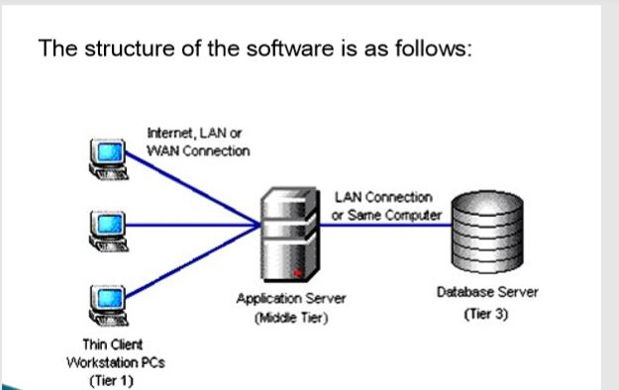
ARCHITECTURE

Slide 14
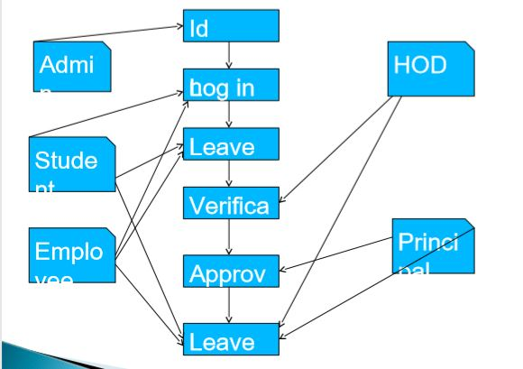
USE CASE DIAGRAM

Slide 15
SOURCE CODE:
Project Link: https://github.com/fahad065/ELMS.git

Slide 16
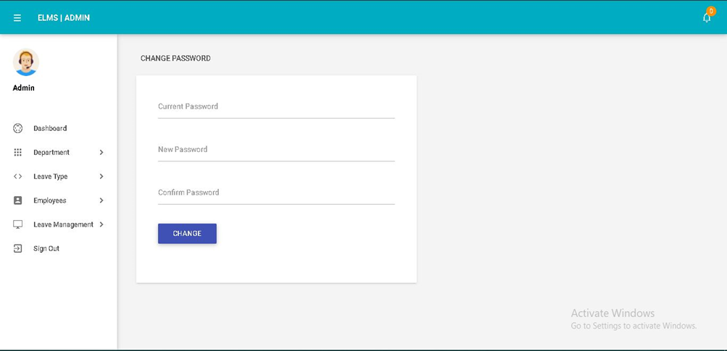
OUTPUT SCREENSHOTS:
Fig 1: Admin Dashboard

Slide 17
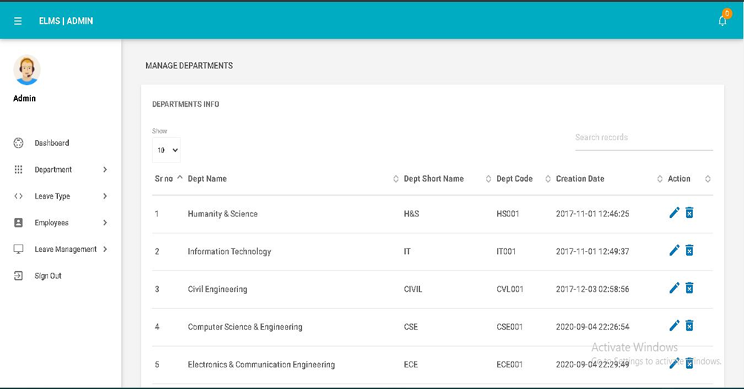
Fig 2: Admin Department List

Slide 18
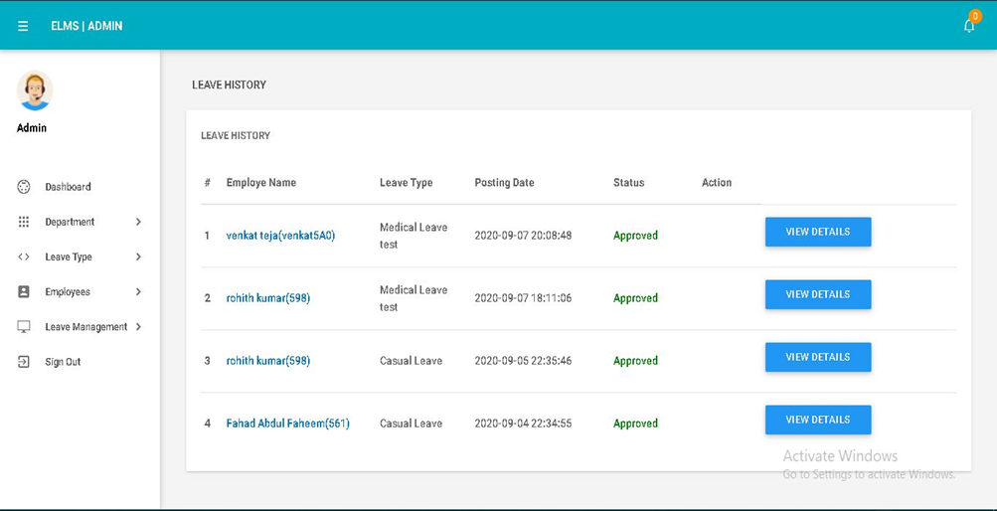
Fig 3: Admin Leave History

Slide 19
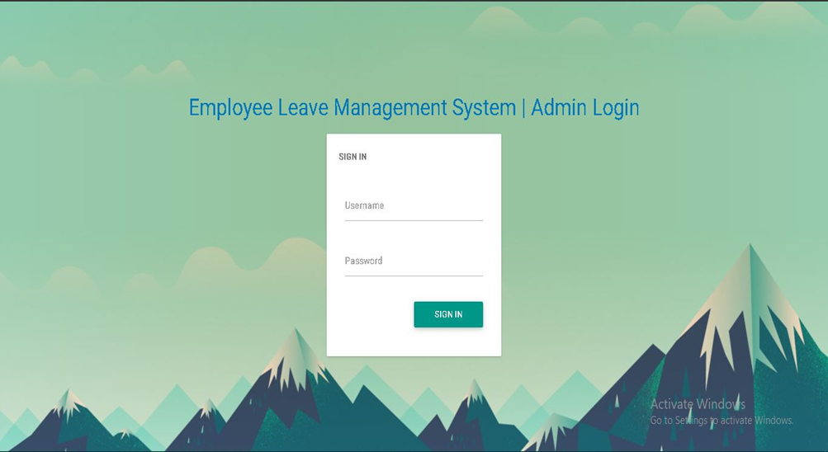
Fig 4: Admin Login

Slide 20
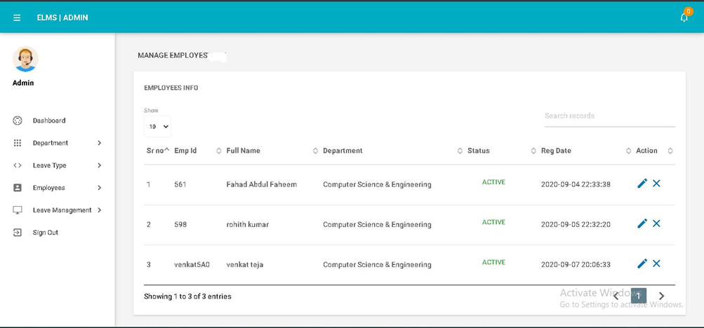
Fig 5: Admin Manage Employee

Slide 21
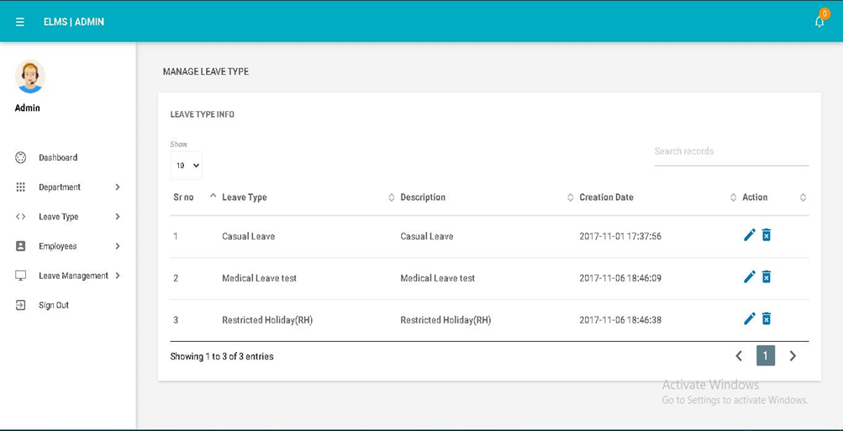
Fig 6: Admin Manage Leave Type

Slide 22
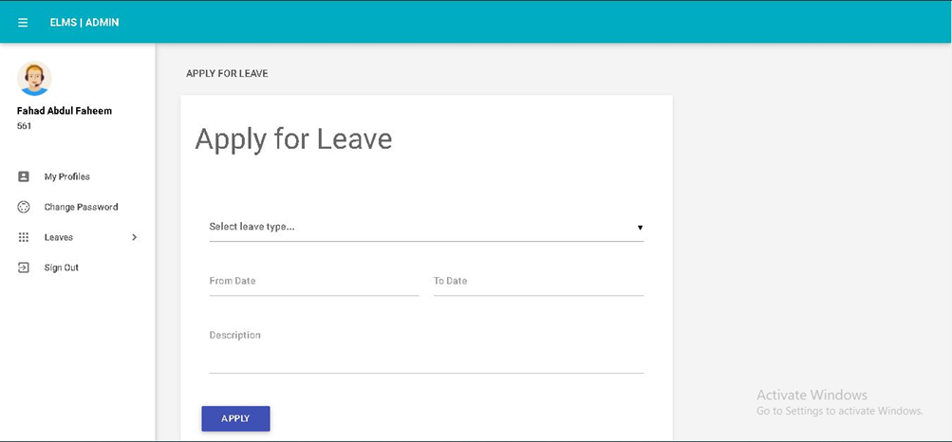
Fig 7: Employee Apply Leave

Slide 23
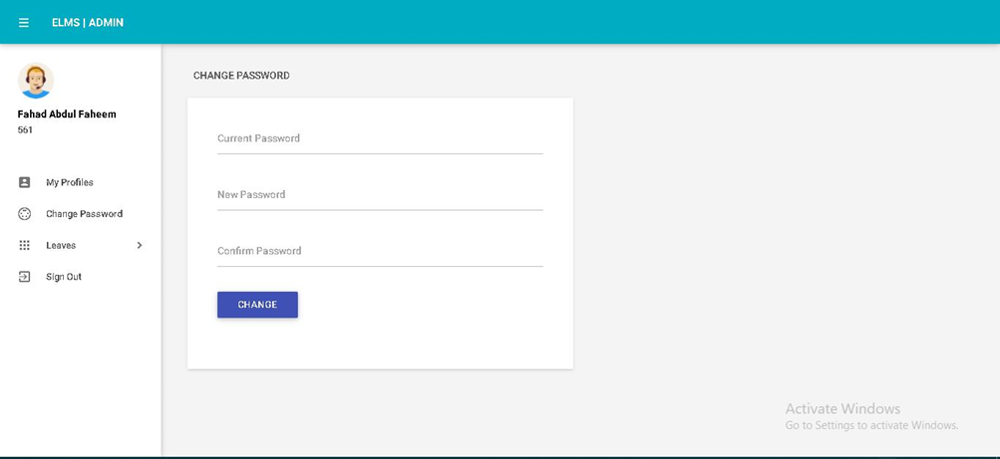
Fig 8: Employee Dashboard

Slide 24
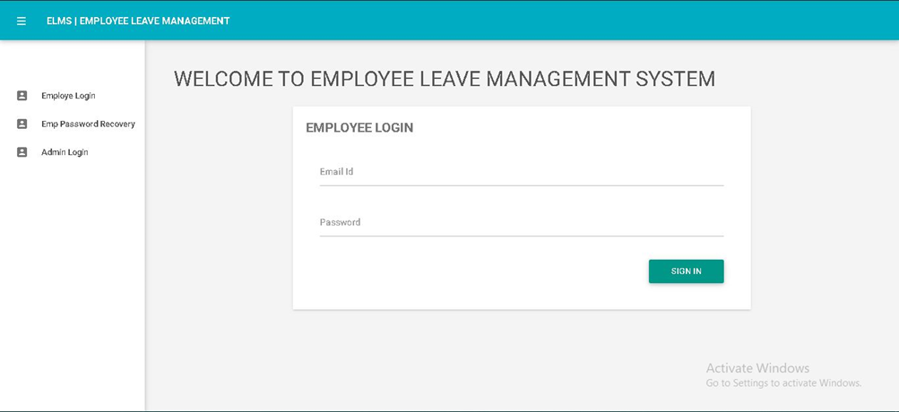
Fig 9: Employee Login Page

Slide 25
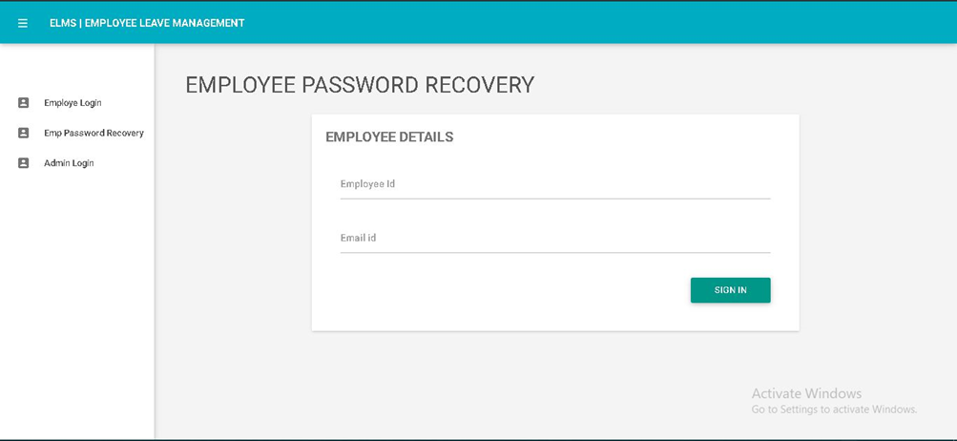
Fig 10: Employee Password Recovery

Slide 26
CONCLUSION
Leave Management System(LSM) is very useful for college to maintain the leave records of the students and employees. This system not only maintains the leave details of the staff, is also maintains the leave applications of the staff and students.
The higher authorities may accept or reject the leave applications requested by the staff. Thus this system maintains the excess amount of job done by college to maintain the leaves.

Slide 27


